Slide 1

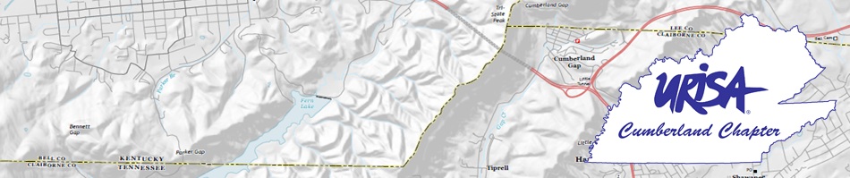
A Surveyor’s Perspective of GIS Benny Moorman, TN Association of Professional Surveyors

Slide 2
What Surveyors Understand GIS to Be
Definition: A geographic information system, or GIS, is a computerized data management system used to capture, store, manage, retrieve, analyze, and display spatial information.
Very broad definition with inherent ambiguity to accuracy and reliability
Varying degrees of accuracy such as a GPS to drive your car, a handheld to use hunting vs. Survey grade RTK, etc.

Slide 3
What Surveyors Understand GIS to Be
Data captured and used in a GIS commonly are represented on paper or other hard-copy maps.
The internet and common phone apps have put GIS information into the hands of the public at an amazing rate.
Basemaps, and more specifically boundary lines, are based on a database of “Tax Maps” that are riddled with inaccuracies and ambiguity.
We are taught as surveyors to regard “tax map lines” with skepticism for lack of accuracy and legal liability in their depiction.

Slide 4
What is Surveying?
“Practice of land surveying” means and service of work, the adequate performance of which involves the application of special knowledge of the principles of mathematics, the related physical and applied sciences and the relevant requirements of law for adequate evidence to the act of measuring and locating lines, angles, elevations, natural and man-made features in the air, on the surface of the earth, within underground workings and on the beds of bodies of water for the purpose of determining areas and volumes, for the monumenting of property boundaries and for the platting and layout of lands and subdivisions of land, including the topography, drainage, alignment and grades of streets, and for the preparation and perpetuation of maps, records, plats, field notes, records and property descriptions that represent these surveys.
Measuring and mapping in regards to GIS falls under this definition. It should be considered that GIS should be overseen / advised by the Surveying industry just as drones are by the Aviation industry.

Slide 5
Surveyors do Respect Proper and Useful Purposes for GIS Services
Utility companies locating meters, customers, etc.
The degree of accuracy for this is not necessary to be at “survey grade” and utility companies would not likely spend the amount of money necessary to hire a professional surveyor to do so.
Navigation: i.e. driving, etc.
Large surveys relating to features that do not specify boundary lines: ex. Campsites & trails in a National Park, etc.
Countless others…

Slide 6
Concerns We Have
Example: Arizona reporter in a television interview with the local Property Assessor told the public that there is no need to hire a surveyor because they can just use the tax map to find lines.
City of Blaine, Minnesota Blaine City Connect website: http://www.ci.blaine.mn.us/index.cfm?id=901915#.VMEadUfF9-5
Official on video “…worst case scenario, hire a surveyor…typically you can find them yourself…”
Personal example on Maytown Road in Carroll County, TN
Land owner used tax map to place a railroad crosstie and cedar post fence more than 6 rows into a farmer’s crops
His property had been surveyed by a licensed surveyor and the neighboring farm had be retraced by a second licensed surveyor
Some online maps show property lines running through homes (http://www.kgis.org/KGISMaps/map.htm?map=aerial&box=2522590:610911:2524272:611847

Slide 7
Tax Map vs. Survey

Slide 8
Solutions and Goals
Establish a clear understanding of what services can be provided by GIS and what cannot.
The GIS industry working closely with Surveying Professionals to improve the “basemaps” and encourage the public to hire a licensed surveyor rather than actively discourage the hiring of a professional.
Educate the public more clearly as to the inaccuracies that are present within GIS services to avoid confusion and harm to the public.
Open discussion for other ideas…

